Slide 1
Session 2: Country eligibility and towards a better targeting of concessional finance
Suzanne Steensen
Senior Policy Analyst, DCD, OECD

Slide 2
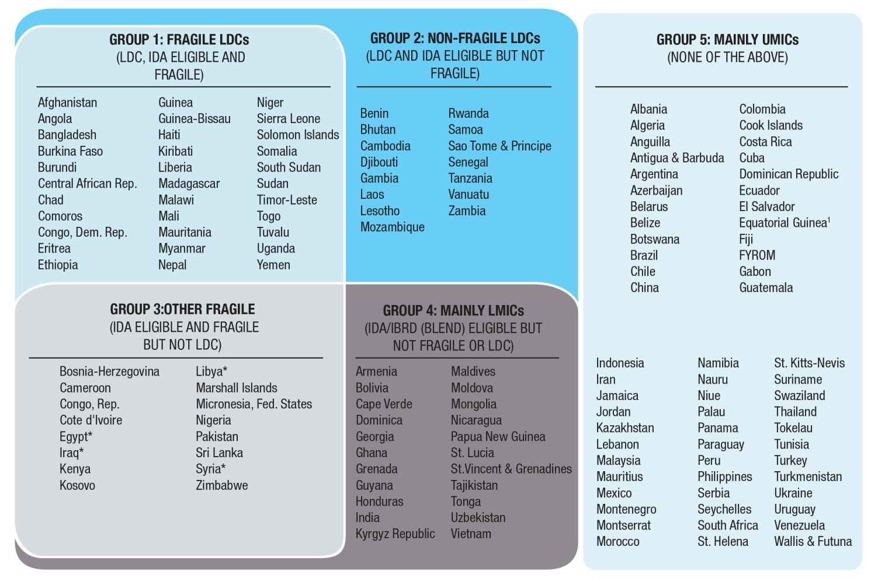
The DAC List of ODA Recipients - Large Heterogeneity
IBRD graduation spans across groups 3, 4 and 5.

Slide 3
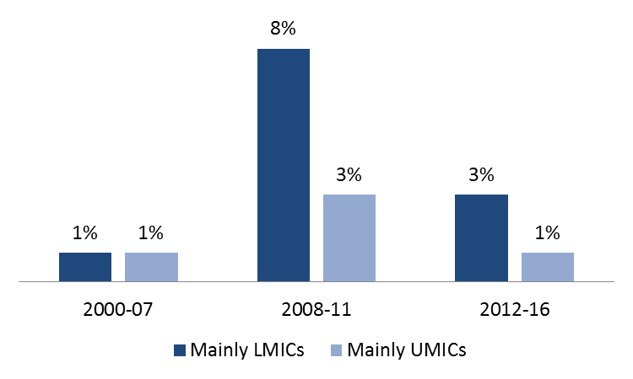
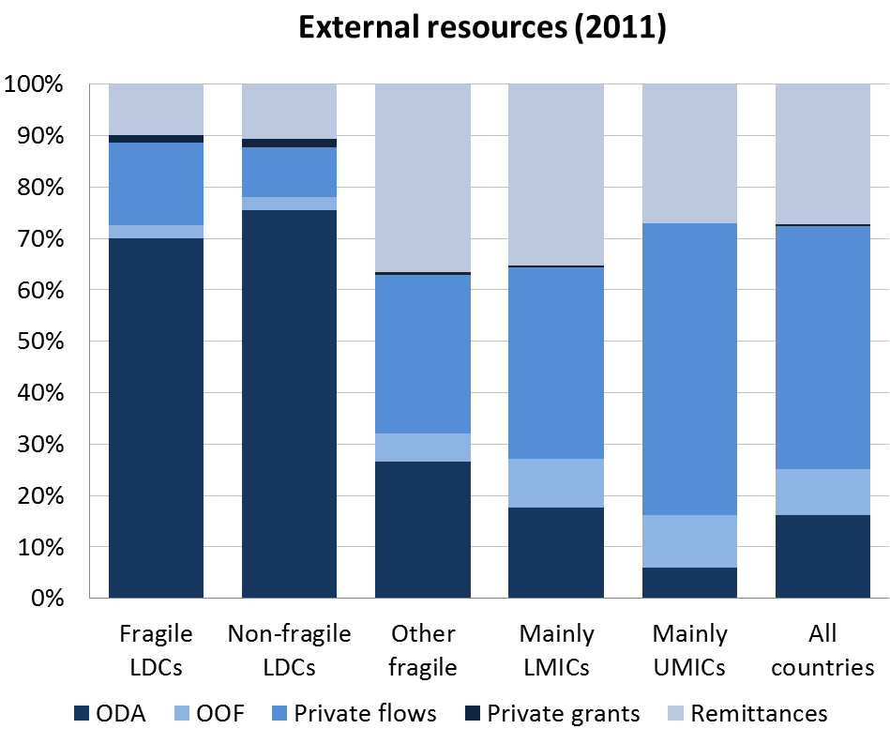
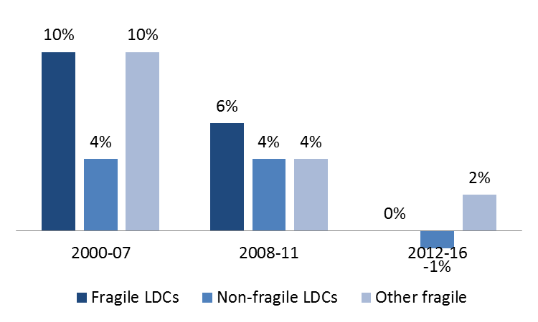
2) ODA growth is accelerating for most MICs..
Large heterogeneity in the List in terms of access to external resources
1) Aid-dependency divide between LDCs and non-LDCs. For LDCs ODA is still over 70% of external finance
…but not for LDCs and fragile states

Slide 4
The post-2015 debate on eligibility and targeting
Greater focus on countries most in need, particularly if poverty is to be eradicated by 2030;
While continuing to support middle income countries in meeting their development challenges, incl. reducing inequality and financing global public goods.
How do we achieve this?
Reform the graduation process from the DAC List of ODA Recipients? Or keep status quo?
Set ODA (or ODA modalities) targets for specific groups of countries?
Valorise a broader provider effort and recipient benefits?

Slide 5
Tighter standards for ODA graduation?
Graduation from the DAC List only happens at USD 12 615 in 2012 or join the EU or G8;
A solution could be to move to the threshold at which countries start the graduation from IBRD lending – currently set at USD 7 115 (this will also enhance consistency between bilateral and multilateral finance);
Impact: 18 countries off the list and DAC net ODA only reduced by 1.7% (mostly Brazil, Mexico, Turkey, Chile)

Slide 6
Donor impact of different graduation scenarios

Slide 7
Status quo? Countries will be graduating anyway…
28 countries are expected to graduate from the DAC list by 2030
13
29
27
26
22
14
25
23
15
18
21
16
19
24
17
20
28
30
12
* Libya exceeded the threshold in 2012, but is predicted to drop below for a year again in 2013.
FYROM – Former Yugoslav Republic of Macedonia

Slide 8
We also need better targeting and focus… Options:
Give more prominence to the UN target of providing 0.15% - 0.20% of GNI as ODA to LDCs, and perhaps increase the level ambition, but there is an inherent challenge for it to co-exist with the 0.7% target;
Establish a spending target for LDCs, e.g. at least 50% of ODA to LDCs;
If ODA in the future measures the “grant equivalent” of loans (instead of their face value), automatically less ODA would be reportable to MICs;
Monitor modalities e.g. grant allocations?
Increased focus and targeting would need to be coupled with more prominent measures of provider efforts (TOSD) and recipient benefits, which will also incentivise continued efforts toward MICs!

Slide 9
For more information www.oecd.org/dac

Slide 10
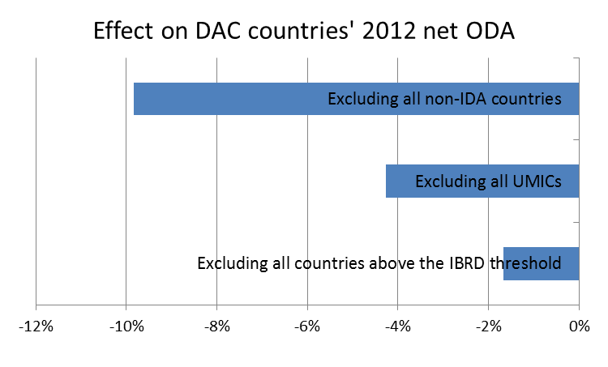
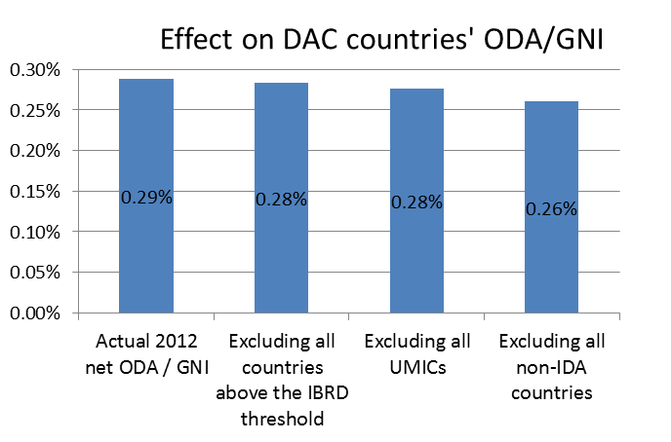
Aggregate impacts of different ways of revising the DAC List

